Slide 1
Lecture 16
Graph Coloring

Slide 2
Graph Colouring Problem
Graph coloring problem is to assign colors to certain elements of a graph subject to certain constraints.
Edge Colouring
Face colouring
Vertex Colouring

Slide 3
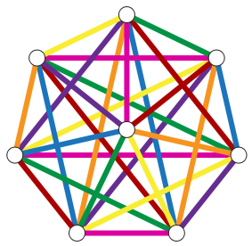
Edge Coloring Problem
The edge-coloring problem asks whether it is possible to color the edges of a given graph using at most k different colors, for a given value of k, or with the fewest possible colors.

Slide 4
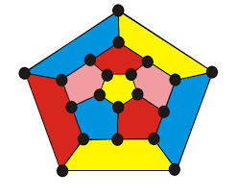
Face Coloring Problem
A planar graph divides the plane into a set of regions, also called faces.
This problem assigns a color to each face or region so that no two faces that share a boundary have the same color.

Slide 5
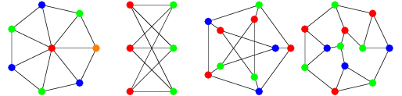
Vertex coloring problem
Vertex coloring is an assignment of labels or colors to each vertex of a graph such that no edge connects two identically colored vertices

Slide 6
Vertex Coloring Problem
Vertex coloring is the most common graph coloring problem.
Also known as M-colorability decision problem.
Goal: To find the smallest integer m for which the graph G can be colored.
The integer is known as a chromatic number of the graph.

Slide 7
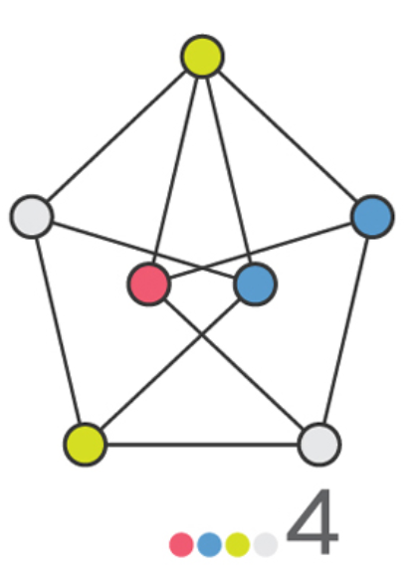
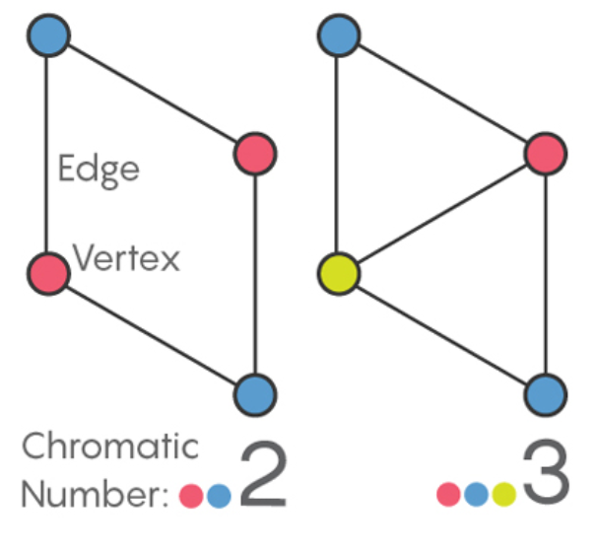
Chromatic number

Slide 8
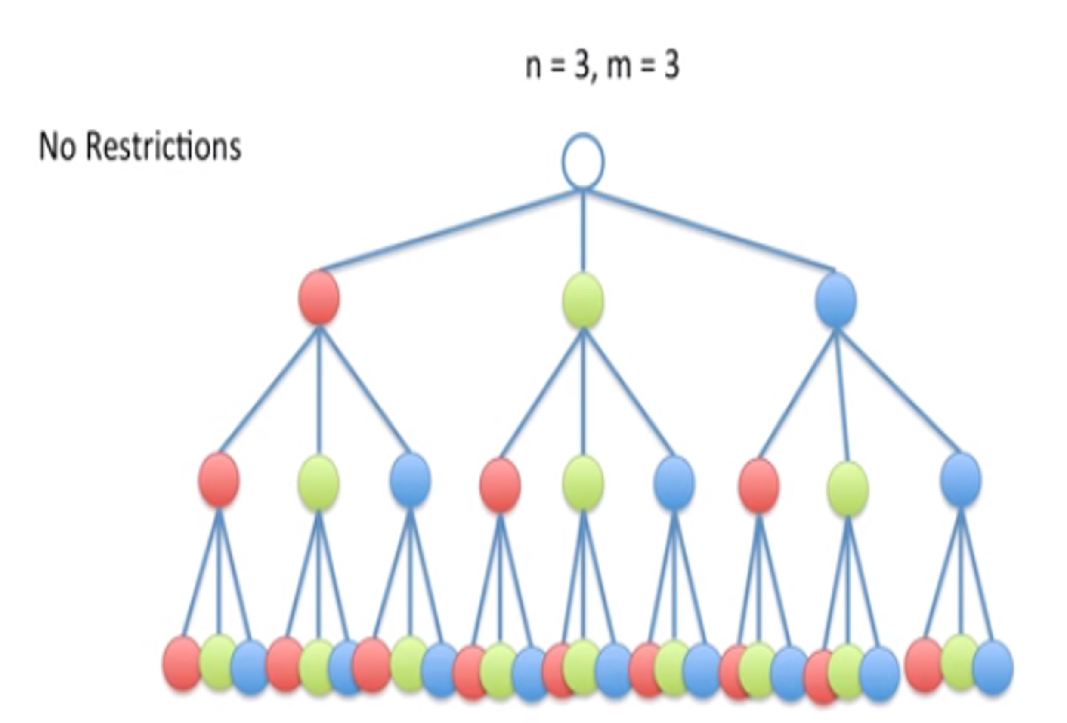
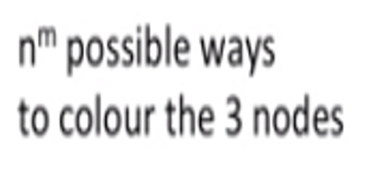
Vertex coloring problem

Slide 9
Vertex Colouring Problem
Input:
An undirected graph G = (V, E) and an integer k.
Output:
An assignment of one of k colors to each node, such that adjacent nodes get different colors.

Slide 10
Procedure
Color first vertex with first colour.
Do following for remaining V-1 vertices
Consider the currently picked vertex Colour it with the lowest numbered colour that has not been used on any previously colored vertices adjacent to it.
If all previously used colors appear on vertices adjacent to v, assign a new color to it .

Slide 11
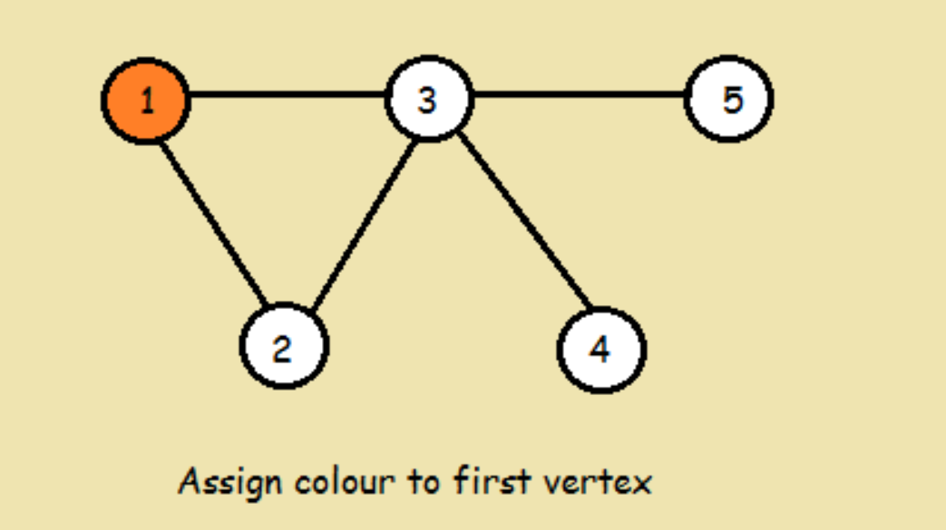
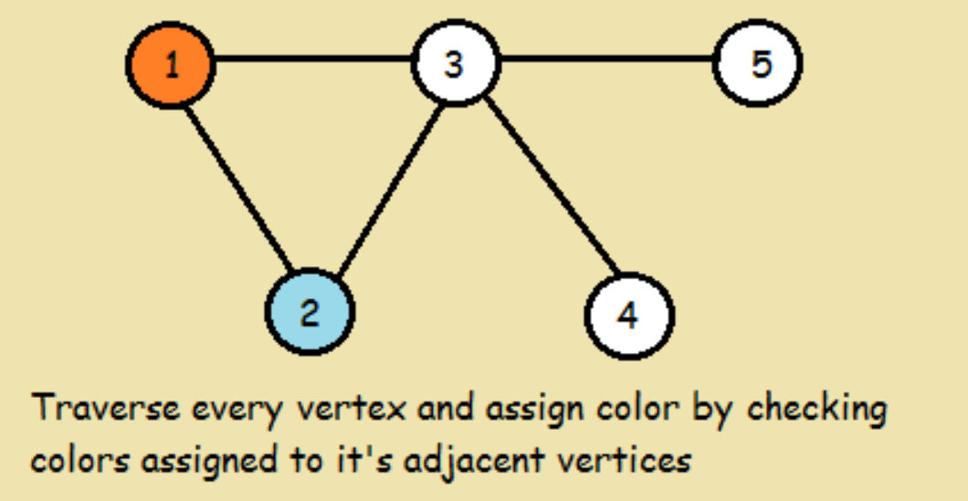
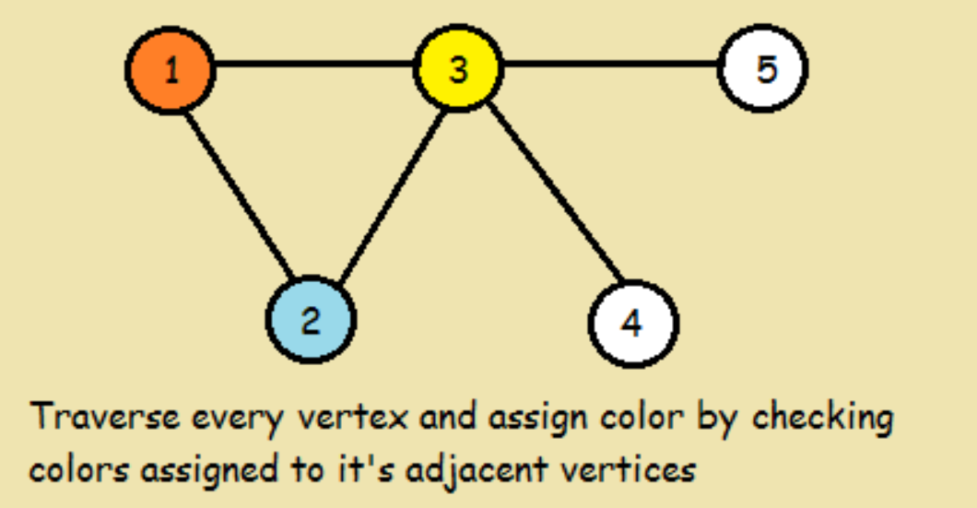
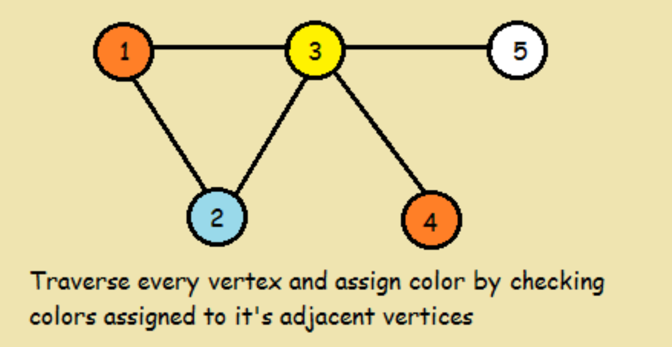
Example: Graph Coloring

Slide 12
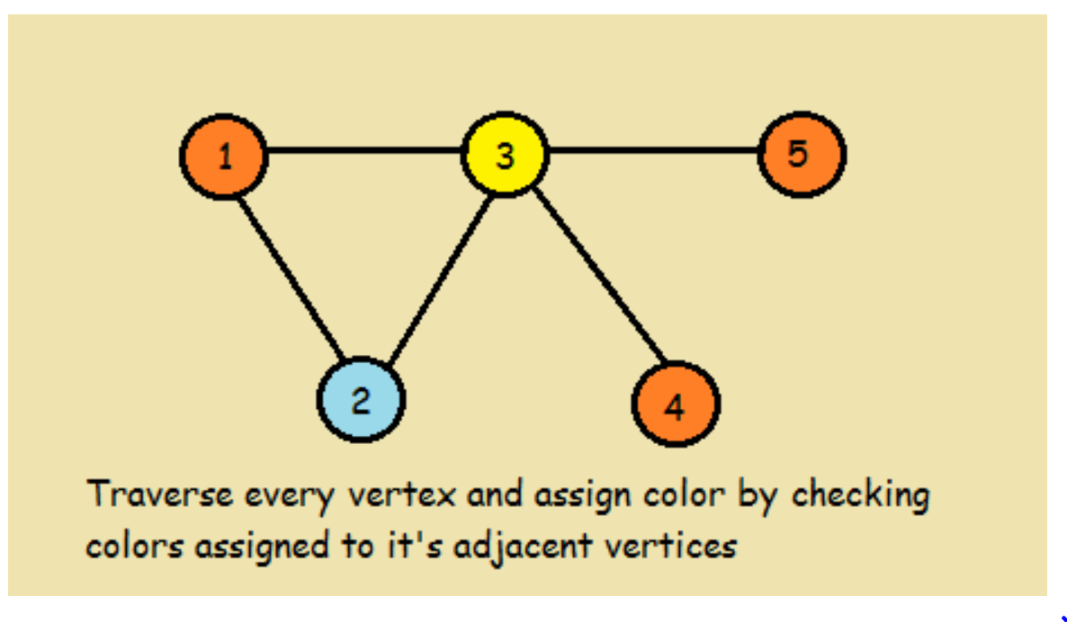
Example: Graph Coloring

Slide 13
Algorithm: Part I

Slide 14

Algorithm: Part II

Slide 15
Example 2: Vertex coloring

Slide 16
Example 2: Vertex coloring

Slide 17
Example 2: Vertex coloring

Slide 18
Example 2: Vertex coloring

Slide 19
Example 2: Vertex coloring
graphColour(0)

Slide 20
Example 2: Vertex coloring
graphColour(1)

Slide 21
Example 2: Vertex coloring

Slide 22
Example 2 : Illustration

Slide 23
Example 2 : Illustration

Slide 24

Complexity Analysis
Complexity for vertex coloring algorithm:
O(n*m^{n})
Where,
n=number of vertices in the graph,
m= number of colors.

Slide 25
Applications: Graph Coloring Problem
Making Schedule or Time Table
Mobile Radio Frequency Assignment
Register allocation: In compiler optimization, register allocation is the process of assigning a large number of target program variables onto a small number of CPU registers.
Sudoku solver: Sudoku is also a variation of Graph coloring problem where every cell represents a vertex. There is an edge between two vertices if they are in same row or same column or same block. (This application is available under Applications Package).
Bipartite Graphs: We can check if a graph is Bipartite or not by coloring the graph using two colors. If a given graph is 2-colorable, then it is Bipartite, otherwise not.
Map Coloring: Geographical maps of countries or states where no two adjacent cities cannot be assigned same color. Four colors are sufficient to color any map.

Slide 26
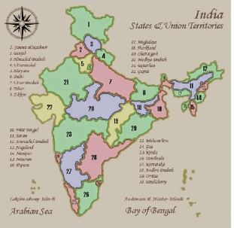
Map coloring
The standard approach to coloring a map is to use a single color for a state and never use the same color for two states.
Two states whose common border is just one point can be colored, if we so choose, with the same color.

Slide 27
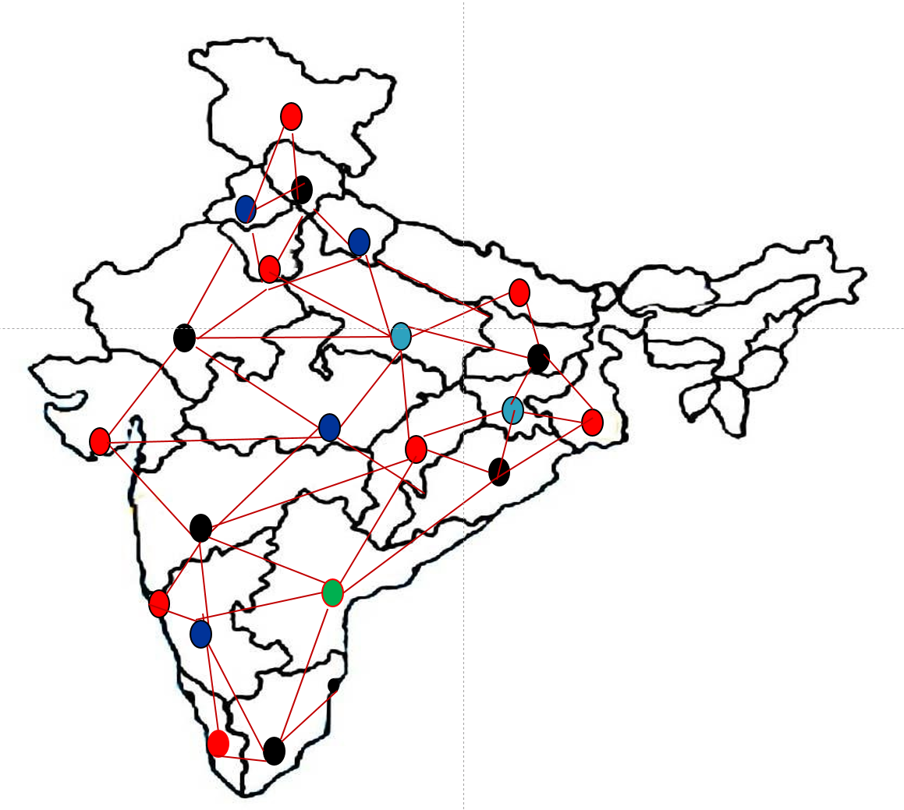
Map coloring

Slide 28
Quiz
What is a chromatic number? a) The maximum number of colors required for proper edge coloring of graph b) The maximum number of colors required for proper vertex coloring of graph c) The minimum number of colors required for proper vertex coloring of graph d) The minimum number of colors required for proper edge coloring of graph
What will be the chromatic number for an empty graph having n vertices? a) 0 b) 1 c) 2 d) n
How many unique colors will be required for proper vertex coloring of a complete graph having n vertices? a) 0 b) 1 c) n d) n!

Slide 29
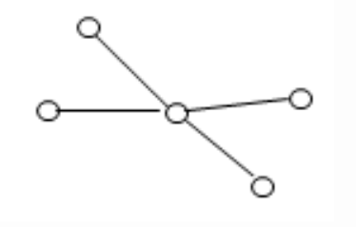
Quiz
4. How many unique colors will be required for vertex coloring of the following graph?
a) 1 b) 2 c) 3 d) 4

Slide 30
Solutions
C
b Explanation: An empty graph is a graph without any edges. So the chromatic number for such a graph will be 1.
c Explanation: A complete graph is the one in which each vertex is directly connected with all other vertices with an edge. So the number of unique colors required for proper coloring of the graph will be n.
b Explanation: The given graph will only require 2 unique colors so that no two vertices connected by a common edge will have the same color. All nodes will have the same color except the central node.

